Slide 1
Models of the motor system
Spring 2025
Opher Donchin

Slide 2
Part 1
Manifolds

Slide 3
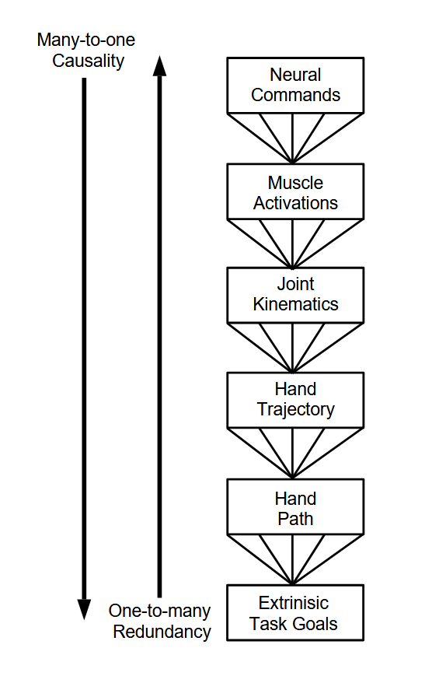
Multiple levels of control
Jordan The Cognitive Sciences 6th Edition 1999

Slide 4
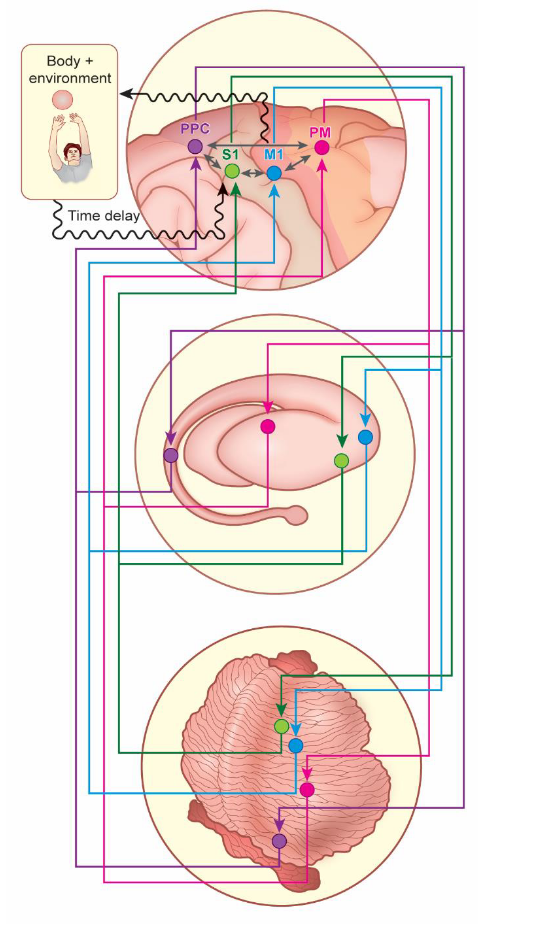
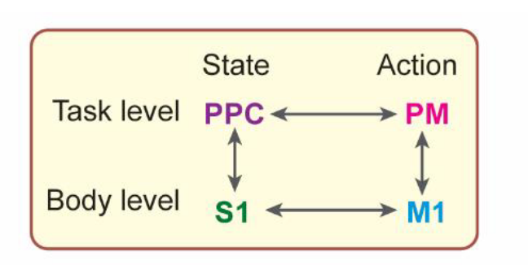
A hierarchical view of the motor system
Real world tasks require coordinating multiple representations of the world
Haar JoCN 2020

Slide 5
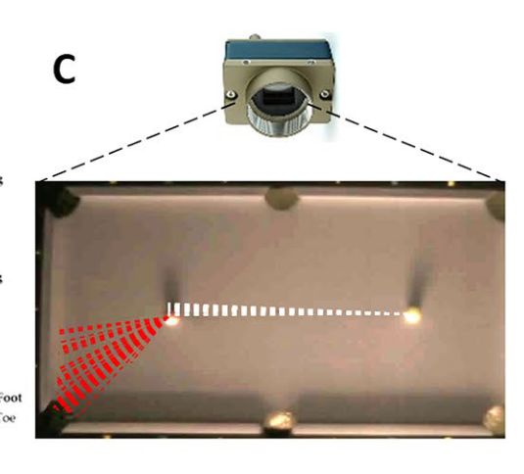
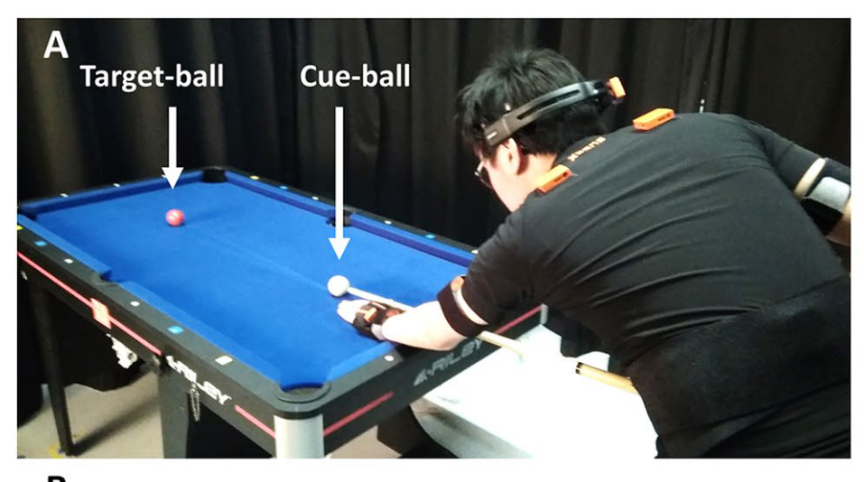
Understanding a real world task
Haar Scientific Reports 2020

Slide 6
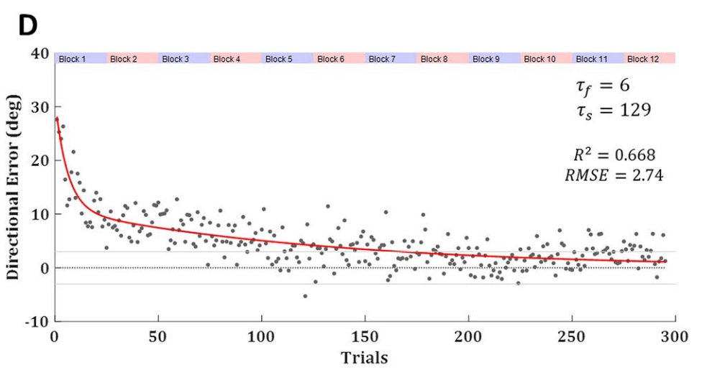
Learning in the billiards task
Haar Scientific Reports 2020

Slide 7
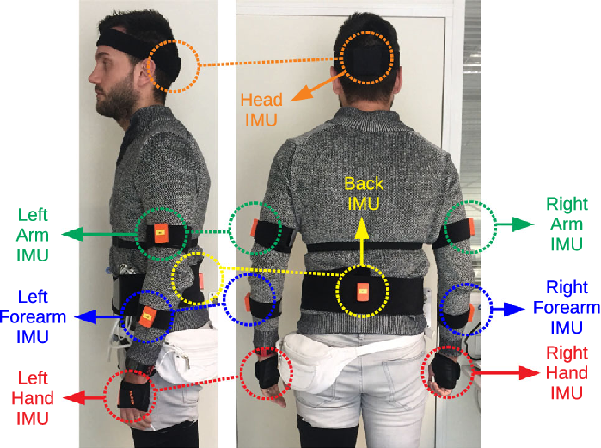
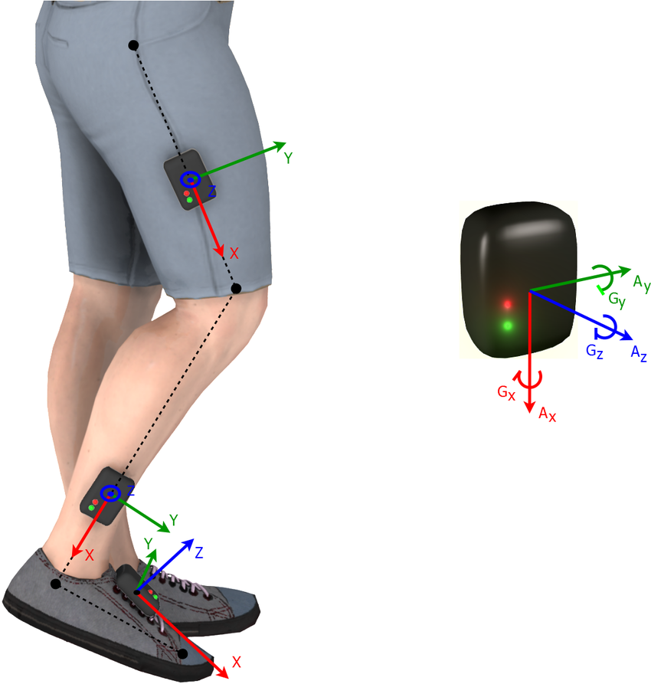
Intertial motion units
Integrate acceleration to get velocity and position

Slide 8
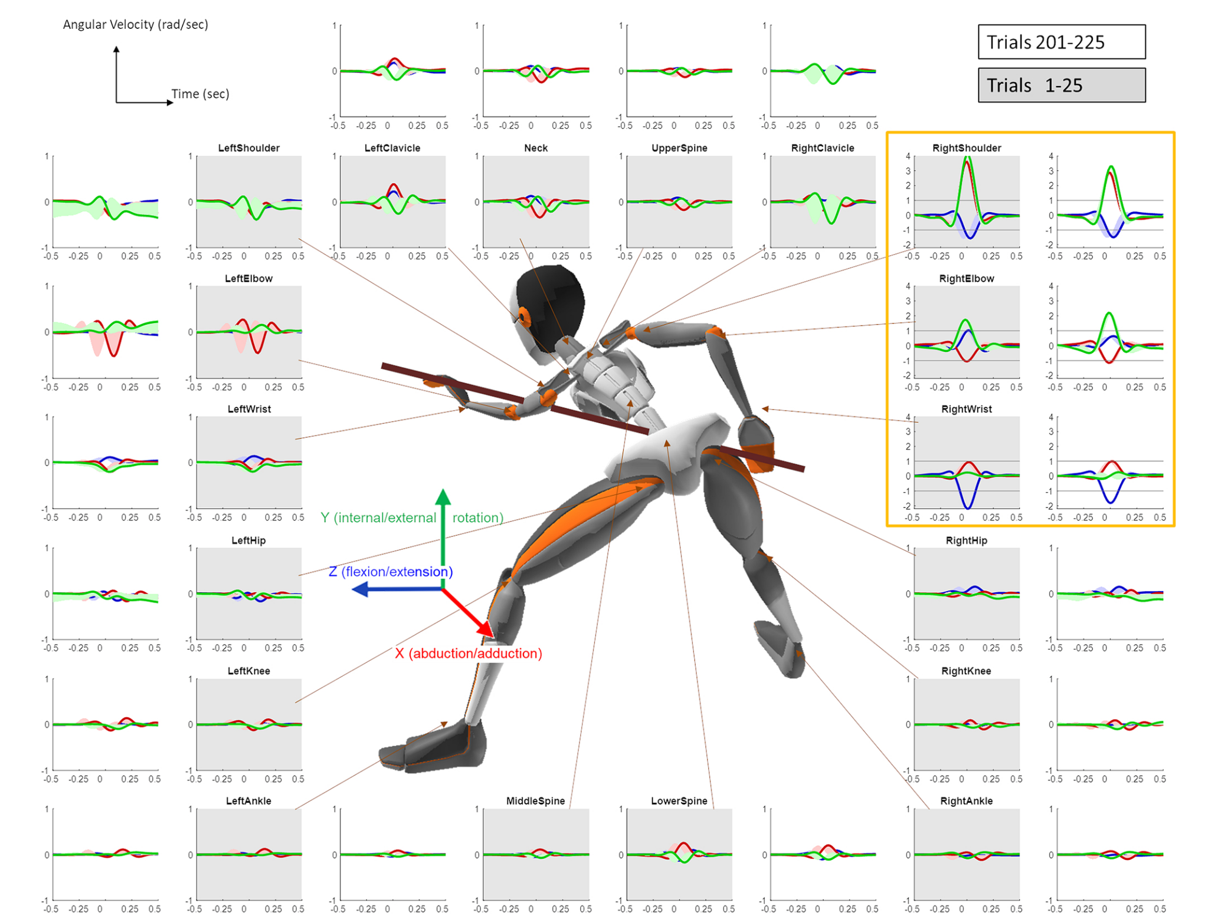
Early and late velocity profiles
Haar Scientific Reports 2020

Slide 9
Generalized variance
Measures how many dimensions it takes to characterize each movement
Haar Scientific Reports 2020

Slide 10
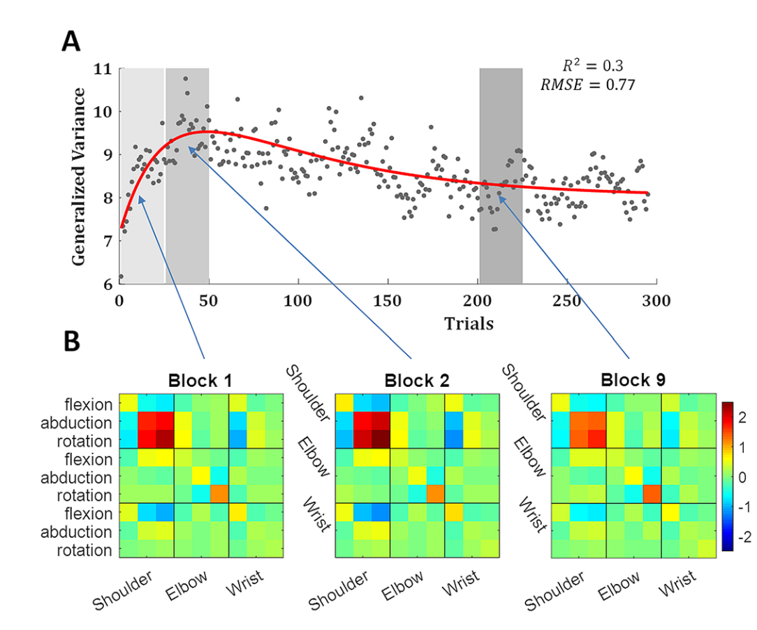
Generalized variance
Increase followed by decrease

Slide 11
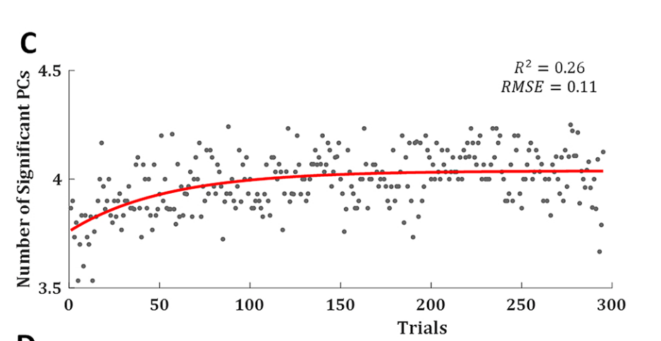
Decreased variance accompanied by increased dimensionality
Haar Scientific Reports 2020

Slide 12
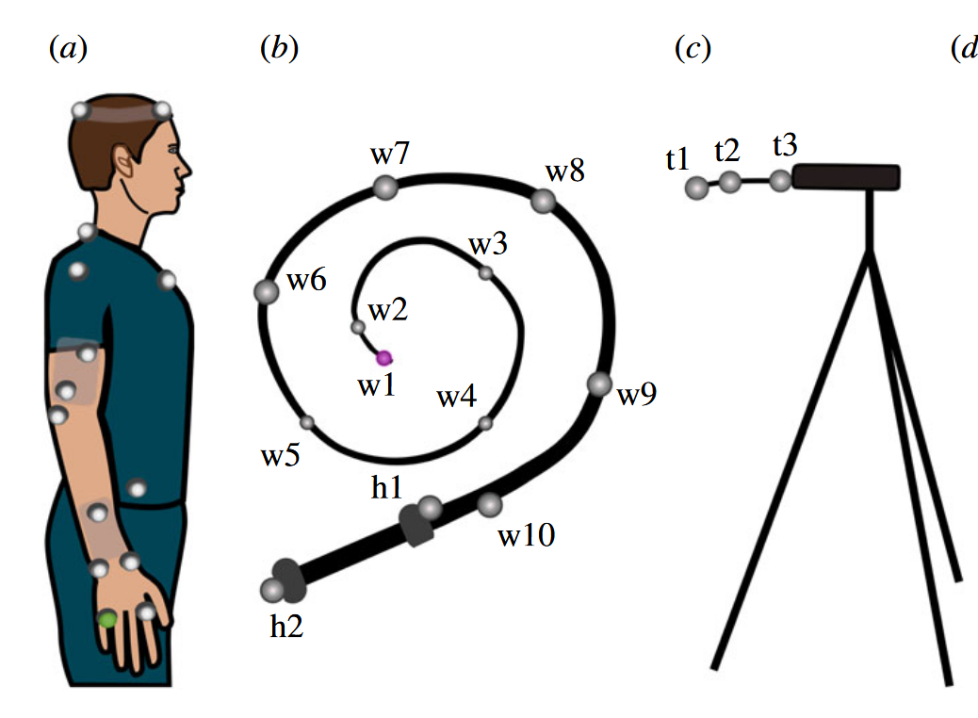
Tracking control of a whip
Krotov Royal Soc Open Sci 2022

Slide 13
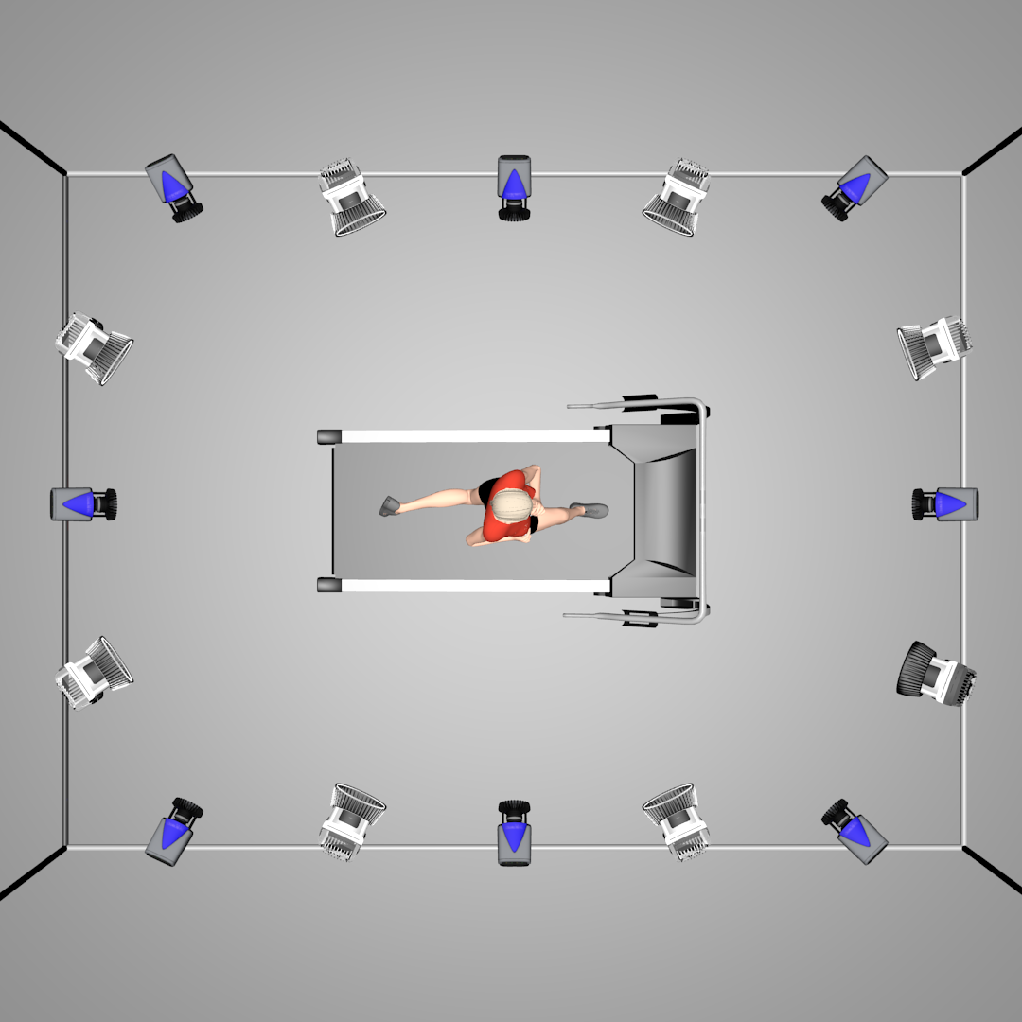
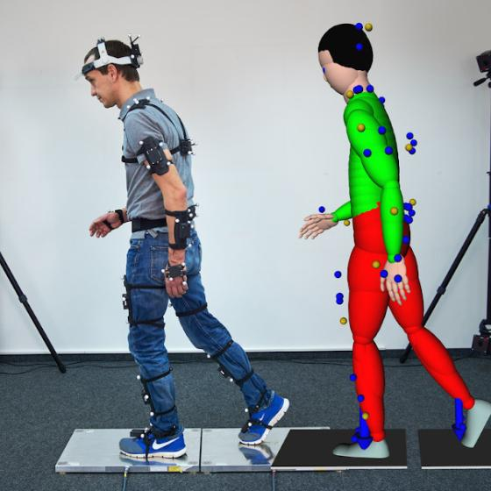
Markered Motion Capture

Slide 14
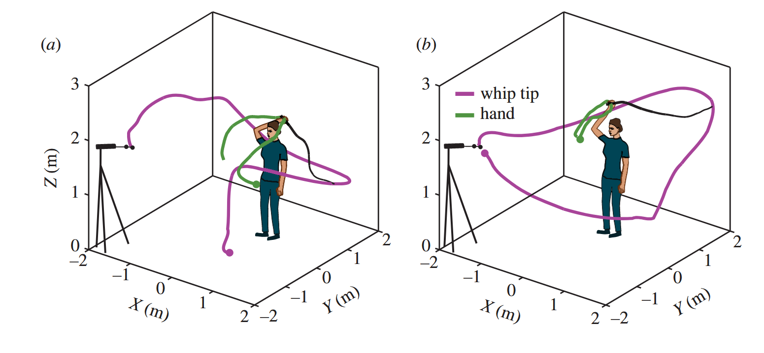
Rhythmic and discrete whipping movements
Discrete
Rhythmic

Slide 15
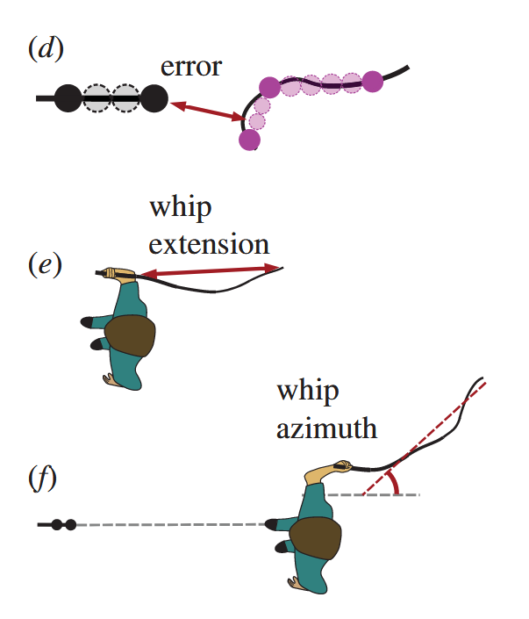
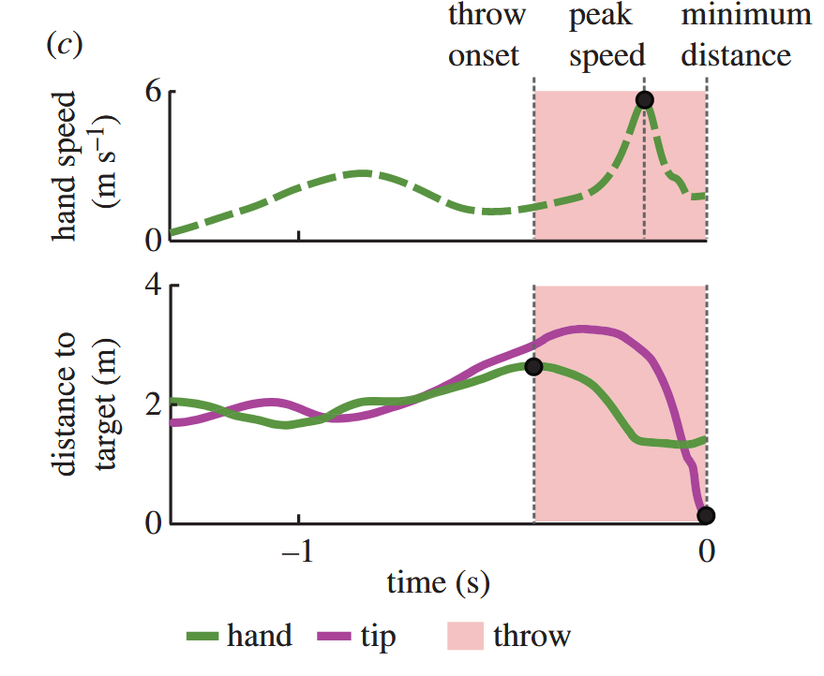
Key variables

Slide 16
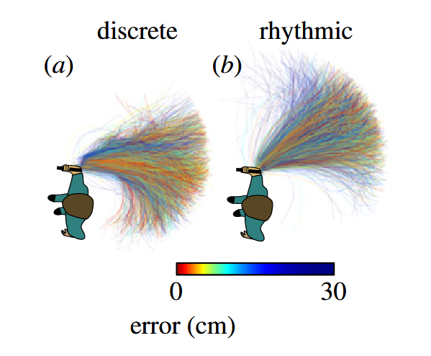
Two strategies

